Slide 1

Clean Code
Agile Software Craftmanship
By Vinanti Thakur
(Tech. Architect)
March 29, 2020

Slide 2
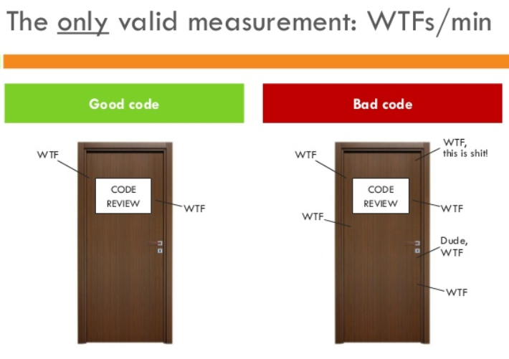
Introduction
Writing clean code is what you must do in order to call yourself a professional.
Clean code is subjective and every developer has a personal take on it.
Best Practice Clean Code.
29 March 2020

Slide 3

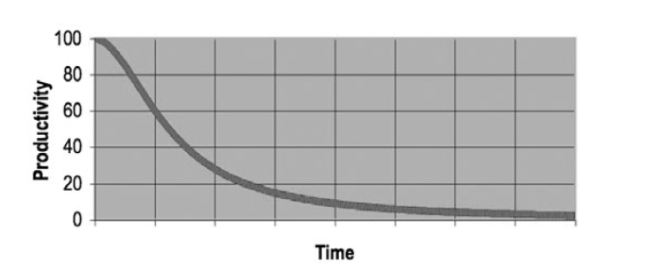
Why Clean Code..??
Reason 1: you are a Programmer.
Reason 2: you want to be a Better Programmer.
The Total cost if Owning a Mess!
29 March 2020

Slide 4
Goal: Code must be…
Readable
Maintainable
Extendable
Testable
29 March 2020

Slide 5
Topics
Meaningful Name
Functions
Comments
29 March 2020

Slide 6
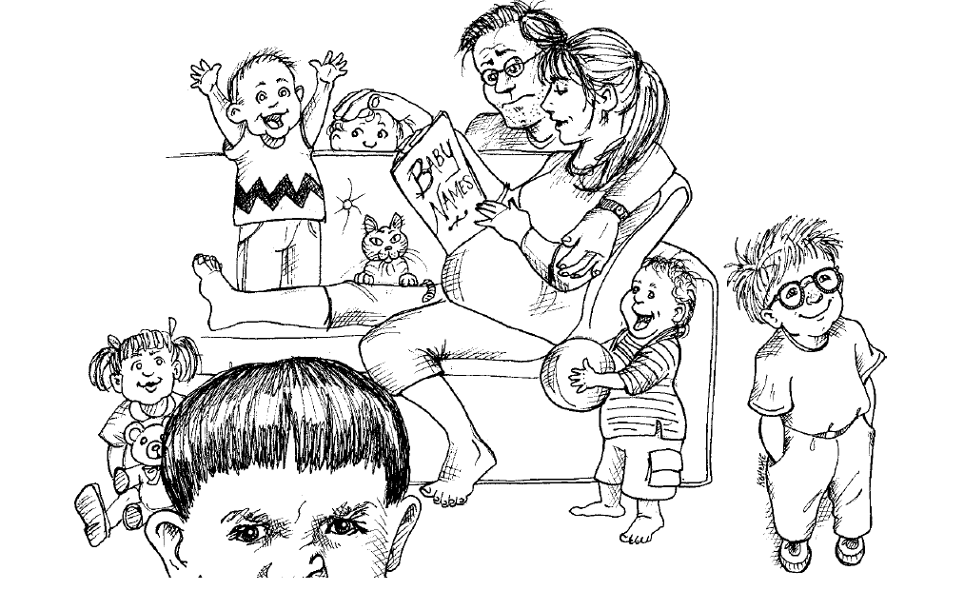
Meaningful Name
Naming Convention is an important in Architecture Modeling.
A naming convention is a set of rules for choosing the names which denote variables, types, functions, and other entities in your code.
Standard naming system must be define in Architectural/coding Document and set as standard.
29 March 2020

Slide 7


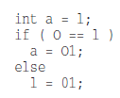
Meaningful Name
Use Intention- Revealing Name:
int d; //elapsed time in days
Int elapsedTimeInDays;
Avoid Disinformation:
29 March 2020

Slide 8



Meaningful Name
Make Meaningful Distinctions:
Use Pronounceable Names:
29 March 2020

Slide 9
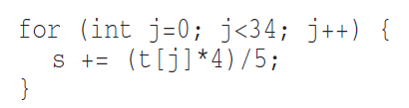
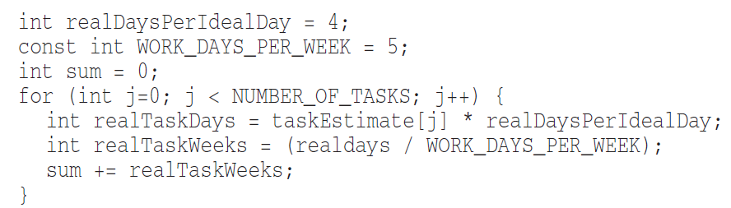
Meaningful Name
Use Searchable Names:
29 March 2020

Slide 10
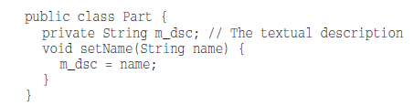
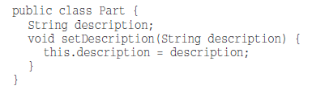
Meaningful Name
Avoid Encoding:
29 March 2020

Slide 11


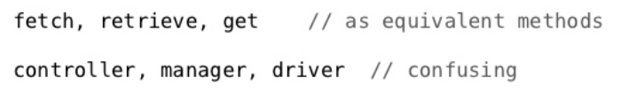
Meaningful Name
Avoid Mental Mapping:
Pick One Word per Concept:
29 March 2020

Slide 12




Meaningful Name
Class Names:
Method names:
29 March 2020

Slide 13
Functions
Functions are the first line of organization in any program.
29 March 2020

Slide 14
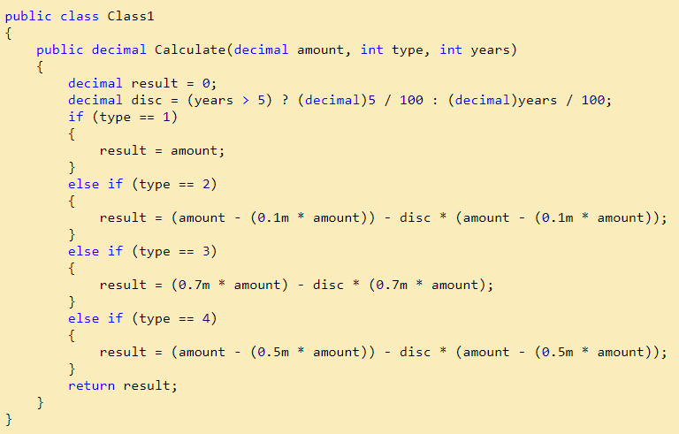
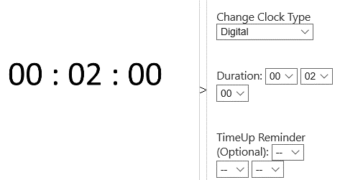
Functions
29 March 2020

Slide 15
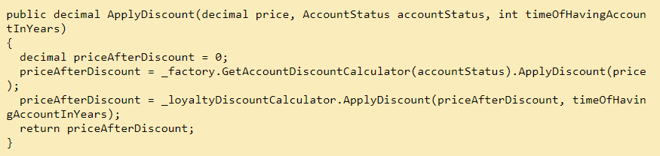

Functions
29 March 2020

Slide 16
Functions
29 March 2020

Slide 17
Functions
Small!
Rules of writing functions()
Should be small
Should be smaller than small
Define rules in organization
< 150 characters / line
< 20 lines
Do One Thing
Functions should do one thing.
They should do it well.
They should do it only.
29 March 2020

Slide 18
Functions
One Level of Abstraction per Function
a very high level of abstraction
getHtml();
an intermediate level of abstraction
String pagePathName = PathParser.render(pagePath);
low level of abstraction
.append("\n")
Mixing levels of abstraction within a function is always confusing.
The Stepdown Rule
Reading Code from Top to Bottom
29 March 2020

Slide 19
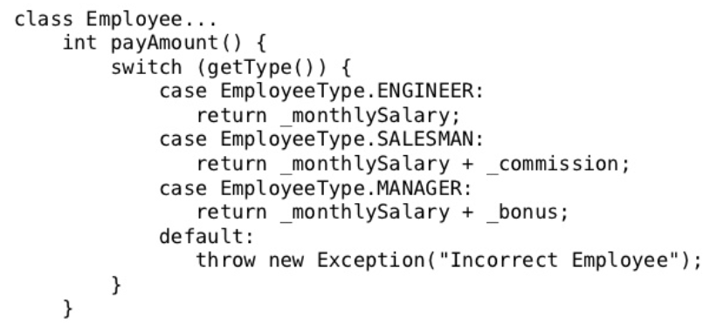
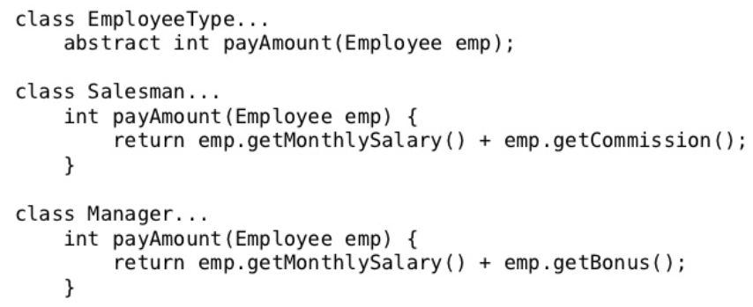
Functions
Switch Statements
By their nature, switch statements always do N things. Unfortunately
we can’t always avoid switch statements, but we can make sure that each switch
statement is buried in a low-level class and is never repeated by using Polymorphism.
29 March 2020

Slide 20
Functions
Use Descriptive Names
Don’t be afraid to make a name long. A long descriptive name is better than a short
enigmatic name.
A long descriptive name is better than a long descriptive comment.
Function Arguments
The ideal number of arguments for a function is zero (niladic).
Next comes one (monadic),
Followed closely by two (dyadic)
Three arguments (triadic) should be avoided where possible.
More than three (polyadic) requires very special justification and then shouldn’t be used anyway.
29 March 2020

Slide 21
Functions
Common Monadic Forms
There are two very common reasons to pass a single argument into a function.
You may be asking a question about that argument, as in boolean fileExists(“MyFile”).
you may be operating on that argument, transforming it into something else and returning it. For example, InputStream fileOpen(“MyFile”)
Flag Arguments
Flag arguments are ugly. E.g. render(true) | render(boolean isSuite)
Passing a Boolean into a function is a truly terrible practice.
complicates the signature of the method – do one thing
It does one thing if the flag is true and another if the flag is false!
Solution: split the function into two: renderForSuite() and renderForSingleTest()
29 March 2020

Slide 22
Functions
Argument Objects – Wrapping arguments
Circle makeCircle(double x, double y, double radius);
Circle makeCircle(Point center, double radius);
Command Query Separation
Functions should either do something or answer something, but not both. Either your
function should change the state of an object, or it should return some information about
that object.
Prefer Exceptions to Returning Error Codes
Extract Try/Catch Blocks
Error Handling Is One Thing
Dependency Management
29 March 2020

Slide 23
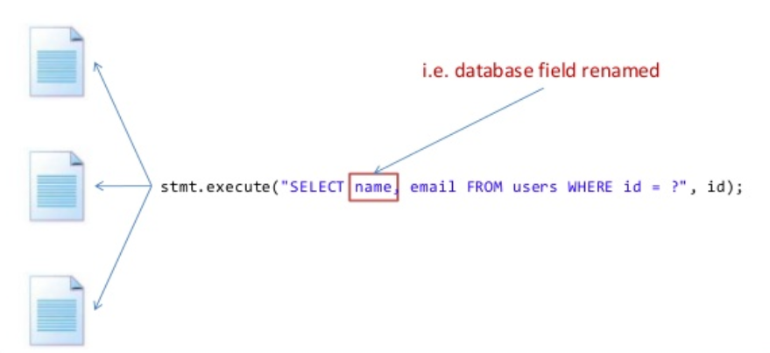
Functions
DRY Principle
Don’t Repeat Yourself
Reuse your code, do not duplicate it
Maintain “single source of truth” – Change once test once
29 March 2020

Slide 24
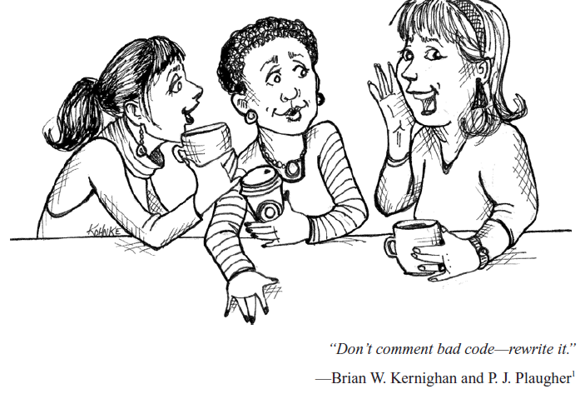
Comments
Comment Do not Make Up for Bad Code
Explain Yourself in Code
29 March 2020

Slide 25
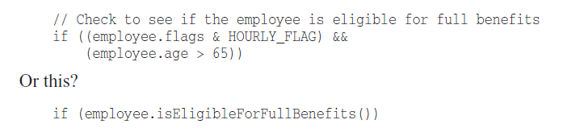
Comments
Example
29 March 2020

Slide 26
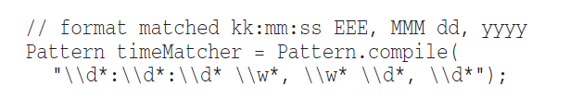
Good Comments
Good Comments - Some comments are necessary or beneficial.
Legal Comments
Sometimes our corporate coding standards force us to write certain comments for legal reasons. For example, copyright and authorship statements
Informative Comments
Sometimes useful to provide basic information with a comment
29 March 2020

Slide 27
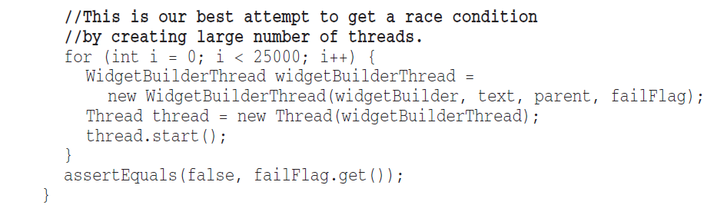
Good Comments
Explanation of Intent
Sometimes a comment goes beyond just useful information about the implementation and
provides the intent behind a decision.
29 March 2020

Slide 28
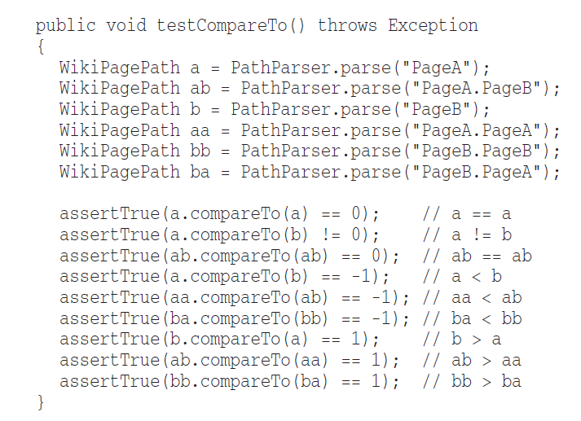
Good Comments
Clarification
Sometimes it is just helpful to translate the meaning of some obscure argument or return
value into something that’s readable.
29 March 2020

Slide 29
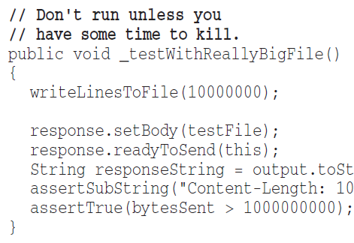
Good Comments
Warning of Consequences
Sometimes it is useful to warn other programmers about certain consequences.
Here, comment explains why a particular test case is turned off.
29 March 2020

Slide 30
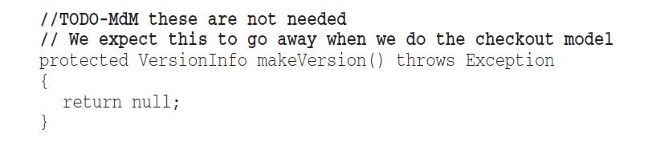
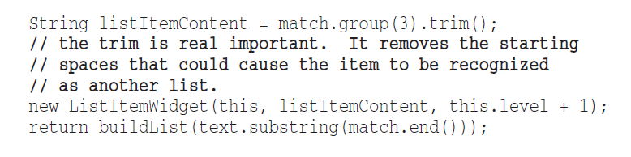
Good Comments
TODO Comments
sometimes reasonable to leave “To do” notes in the form of //TODO comments to explain what that function feature should be
Amplification
A comment may be used to amplify the importance of something that may otherwise seem
inconsequential.
29 March 2020

Slide 31
Bad Comments
Bad Comments - Your Code Should Speak not Comments!! Don’t go for comments!!!
Mumbling
Plopping in a comment just because you feel you should or because the process requires it,
is a hack. If you decide to write a comment, then spend the time necessary to make sure it
is the best comment you can write.
29 March 2020

Slide 32
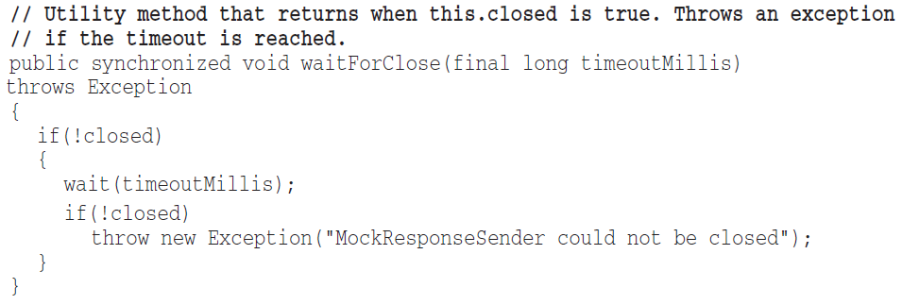
Bad Comments
Redundant Comments
shows a simple function with a header comment that is completely redundant.
The comment probably takes longer to read than the code itself.
Misleading Comments
Sometimes, with all the best intentions, a programmer makes a statement in his comments
that isn’t precise enough to be accurate.
29 March 2020

Slide 33
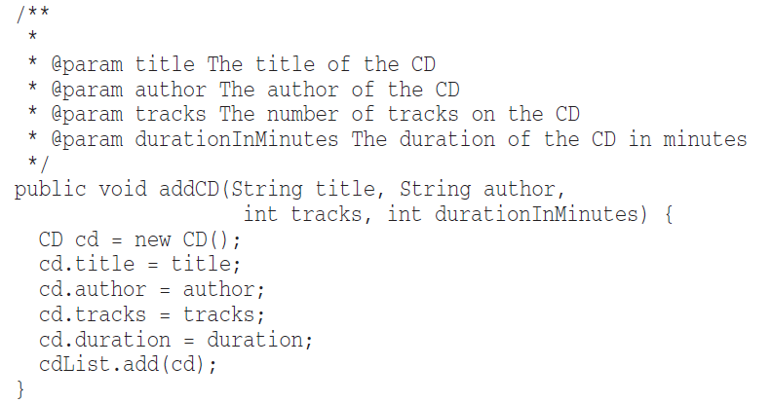
Bad Comments
Mandated Comments
It is just plain silly to have a rule that says that every function must have a javadoc, or
every variable must have a comment. Comments like this just clutter up the code, propagate
lies, and lend to general confusion and disorganization.
29 March 2020

Slide 34
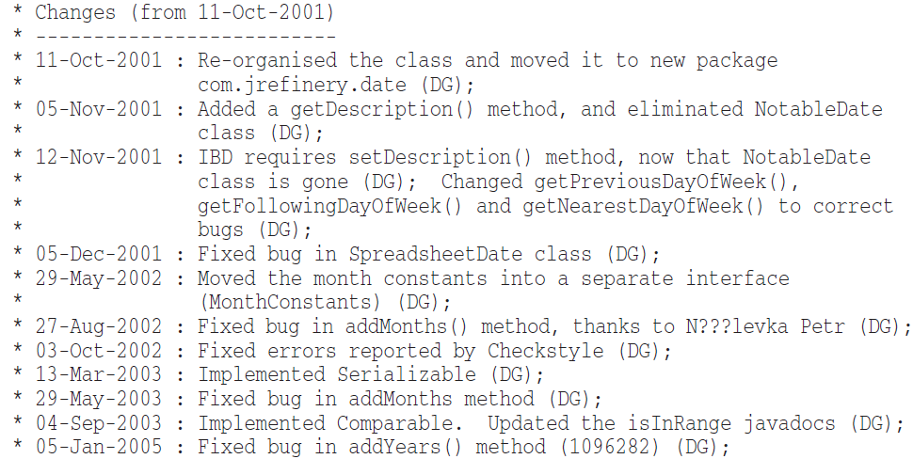
Bad Comments
Journal Comments
Sometimes people add a comment to the start of a module every time they edit it. These
comments accumulate as a kind of journal, or log, of every change that has ever been
made.
29 March 2020

Slide 35
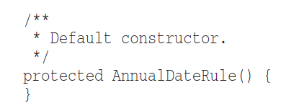

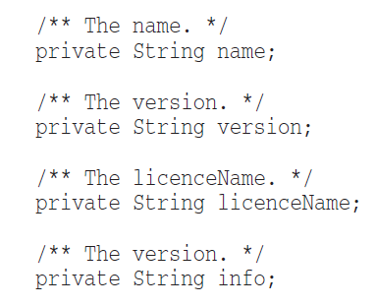
Bad Comments
Noise Comments
Sometimes you see comments that are nothing but noise. They restate the obvious and
provide no new information.
Scary Noise
29 March 2020

Slide 36
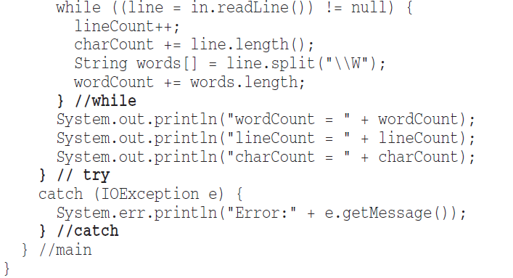
Bad Comments
Don’t use comment when you can use a Function or a Variable
Position Makers - Sometimes programmers like to mark a particular position in a source file.
Closing Bracket Comments
29 March 2020

Slide 37
More Topics…
Formatting
Object and data structures
Error Handling
Boundaries
Unit Tests
Classes
System
Emergence
Concurrency
Successive Refinement
Refactoring
Smells and Heuristics
29 March 2020

Slide 38

Thank You!!!
29 March 2020

